Slide 1
COMP 655: Distributed/Operating Systems
Summer 2011
Dr. Chunbo Chu
Week 3: Communication (cont’d)

Slide 2
Agenda
Communication (cont’d)
RESTful service and JAXB
Exercise (if have time)

Slide 3
http
Communication patterns:
Transient
Query/response
But, http does NOT simulate a procedure call
Non-blocking (officially)
Many clients choose to block
HTTP 1.1 is defined in RFC 2616
Depends on TCP for reliable communication

Slide 4
Steps in an HTTP interaction
Client requests TCP connection
Client and server collaborate to create a TCP connection
Client sends an HTTP request
Server sends a response
TCP connection torn down
In HTTP 1.1, connection can be kept alive

Slide 5
Anatomy of an HTTP request
method
request URI
protocol
POST /don/demo HTTP/1.1
accept: */*
accept-language: en-us
referer: http://localhost:8080/don/echoclient.htm
content-type: application/x-www-form-urlencoded
accept-encoding: gzip, deflate
user-agent: Mozilla/4.0 (compatible; MSIE 6.0; Windows NT 5.1; SV1; NovaPacs Viewer 6.0.197.0; .NET CLR 1.1.4322; .NET CLR 2.0.50727)
host: localhost:8080
content-length: 37
connection: Keep-Alive
cache-control: no-cache
name=007&mission=deep%20dark%20secret
headers
content

Slide 6
Anatomy of an HTTP response
status
code
protocol
reason phrase
HTTP/1.1 200 OK
X-Powered-By: Servlet/2.5
Content-Type: text/xml;charset=utf-8
Content-Length: 57
Date: Sun, 16 Sep 2007 17:55:54 GMT
Server: Sun Java System Application Server Platform Edition 9.0_01
<greeting>Hello, 007. You made a POST request.</greeting>
headers
content

Slide 7
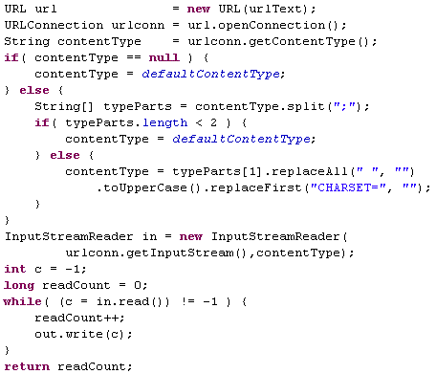
Making an HTTP request in Java

Slide 8
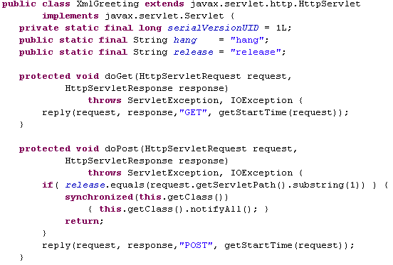
Server side: HttpServlet

Slide 9
Servlet container
Container (Tomcat, Glassfish,
WebLogic, WebSphere, etc)
your Servlet
Servlet
base class
request
client
response
DB
whatever

Slide 10
Smudging the transparency …
Network-unfriendly code
Lots of clients can mean lots of configuration management

Slide 11
Network-unfriendly code …
In OO, there are usually lots of fine-grained classes, and lots of getters and setters
Performance is not good if you do this over a network
Person person = new Person();
person.setFirstName(fname);
person.setMiddleInitial(initial);
person.setLastName(lname);
Address address = new Address();
address.setStreet(street);
address.setCity(city);
address.setState(state);
person.setAddress(address);
…
Notes:
Calling a local setter can be 1,000 (or more) times faster than doing the same thing over a network (sub-microsecond vs millisecond)
Even on a single machine, calls across process boundaries will be very expensive compared to intra-process calls

Slide 12
Network-unfriendly
client
server
domain
object
domain
object

Slide 13
A more network-friendly way
This is a recurring problem in distributed systems
Remote façade and Data transfer object patterns provide the core of a solution
P of EAA page 388, 401
Define a façade class with methods that group multiple fine-grained operations together
Define classes (DTOs) with nothing but getters and setters for moving groups of data items around
Keep the business logic in the original class(es) on the server side

Slide 14
Using Remote Façade + DTO
Client creates a DTO
Client calls lots of setters on DTO
Client calls façade with DTO as parameter
Service calls lots of getters on DTO, setters (and other methods, as needed) on the domain object(s)
Façade creates DTO2
Façade calls setters on DTO2
Façade returns DTO2 to client
Client calls lots of getters on DTO2

Slide 15
Using Remote Façade + DTO
client
server
Façade
DTO
DTO
domain
object
domain
object
DTO2
DTO2

Slide 16
Remote Façade + DTO code (flavor)
PersonTO pto = new PersonTO();
pto.setFirstName(fname);
pto.setMiddleInitial(initial);
pto.setLastName(lname);
pto.setStreet(street);
pto.setCity(city);
pto.setState(state);
Facade facade = new Facade();
ResultTO rto = facade.addPerson(pto);
…
Notes:
Creating the client-side Facade may be elaborate, involving looking up the server in a directory service, authentication, service parameter negotiation, etc

Slide 17
Remote Façade + DTO consequences
Reduced network traffic
Reduced coupling between client and domain model
Costs include
More classes to deal with
Getters and setters called multiple times (client DTO.get, server DTO.get + domain.set)
Risks include
Temptation to put business logic in DTO
Temptation to skip domain model development and build a DTO-processing system

Slide 18
Remote façade + DTO (refactored)
client
server
Façade
PersonTO
PersonTO
Person
+ name
+ addr
before
client
server
Façade
Person
+ name
PersonTO
PersonTO
after
Address

Slide 19
RMI is usually synchronous

Slide 20
Asynchronous RPC (1)
2-12
interconnection between client and server in a traditional RPC
The interaction using asynchronous RPC

Slide 21
Asynchronous RPC (2)
2-13

Slide 22
Communication essentials
Communication patterns
Communication structure: OSI reference model and TCP/IP coverage
Major middleware communication services
RPC
RMI
http
I hate to wait …
Message passing

Slide 23
Looser coupling
In RPC and RMI, client and server must be running at the same time
This coupling makes them relatively sensitive to failures and remote-machine policies
Message queuing enables more loosely-coupled communication

Slide 24
General Architecture of a Message-Queuing System (1)

Slide 25
Message-Queuing Primitives
Primitive | Meaning
Put | Append a message to a specified queue
Get | Block until the specified queue is nonempty, and remove the first message
Poll | Check a specified queue for messages, and remove the first. Never block.
Notify | Install a handler to be called when a message is put into the specified queue.

Slide 26
Consumer message queuing: email
sender’s
email
server
receiver’s
email
server
sender’s
machine
receiver’s
machine
host
comm
server
comm
server
host

Slide 27
Example: IBM MQSeries (WebSphere MQ)
General organization of IBM's MQSeries message-queuing system.
2-31

Slide 28
Message Brokers
2-30
The general organization of a message broker in a message-queuing
system.

Slide 29
Middleware communication summary
RPC
Blocking, transient request/response
RMI
Blocking, transient request/response
http
(officially) non-blocking, transient request/response
Asynchronous RPC
Non-blocking, transient request/response
Message queuing
Non-blocking, persistent producer/consumer

Slide 30
Bonus material

Slide 31
Implementing a Java RMI server and client
Define the remote interface
Write a class that implements it
Include that class in an application
Compile
Generate stub and skeleton with rmic
(not necessary with 1.5)
Start rmiregistry, if necessary

Slide 32
1. Define the Interface
import java.rmi.Remote;
import java.rmi.RemoteException;
public interface HelloInterface extends Remote {
String sayHello(String yourName) throws RemoteException;
String sayGoodbye(int howMany) throws RemoteException;
void ping() throws RemoteException;
}

Slide 33
2. Implement the interface
public class HelloServer extends UnicastRemoteObject implements HelloInterface {
HelloServer() throws RemoteException {
super(Constants.serverPort);
System.out.println(toString());
// Register
Registry reg = LocateRegistry.getRegistry(Constants.rmiPort);
reg.rebind(Constants.serverName, this);
}
…

Slide 34
2. Implement the interface, con’t
public void ping() throws RemoteException {
System.out.println("I've been pinged");
}
public String sayGoodbye(int howMany) throws RemoteException {
StringBuffer sb = new StringBuffer();
for(int i=0;i<howMany;i++) sb.append("goodbye ");
return sb.toString();
}
public String sayHello(String yourName) throws RemoteException {
return "Hello, " + yourName;
}

Slide 35
3. Include in an application
public static void main(String[] args) throws RemoteException {
new HelloServer();
}

Slide 36
6. Start RMI Registry
>> start rmiregistry

Slide 37
Implementation continued
Assign the server a name
Run the server, using that name
Write a class that uses the remote interface (by name)
Compile
Run
Enjoy ☺

Slide 38
8,9. Name the server
public class Constants {
public static final int rmiPort = 5555;
public static final int serverPort = 43215;
public static final String serverName = "whatever";
}

Slide 39
10. Write a client
public class HelloClient {
public static void main(String args[]) throws RemoteException, NotBoundException {
Registry reg = LocateRegistry.getRegistry(Constants.rmiPort);
HelloInterface hi = (HelloInterface) reg.lookup(Constants.serverName);
for( String name : args ) {
System.out.println(hi.sayHello(name));
}
System.out.println(hi.sayGoodbye(args.length));
hi.ping();
}
}

Slide 40
11. Run
>> java HelloClient Alice Bob Carol Dave
Hello, Alice
Hello, Bob
Hello, Carol
Hello, Dave
goodbye goodbye goodbye goodbye
>>

Slide 41
RMI Resources
java.sun.com/j2se/1.5.0/docs/guide/rmi/
java.sun.com/j2se/1.5.0/docs/guide/rmi/faq.html
(Java RMI and Object Serialization FAQ)
java.sun.com/j2se/1.5.0/docs/tooldocs/windows/rmiregistry.html

